Slide 1
Before you begin
If a yellow security bar appears at the top of the screen in PowerPoint, click Enable Editing.
You need PowerPoint 2010 to view this presentation. If you don’t have PowerPoint 2010, download the PowerPoint Viewer (see the URL in the notes pane).
Notes:
Download the PowerPoint viewer at (http://www.microsoft.com/downloads/details.aspx?displaylang=en&FamilyID=cb9bf144-1076-4615-9951-294eeb832823).

Slide 2
Microsoft® Excel® 2010 Training
Use Excel tables to manage information
Notes:
[Notes to trainer:
This presentation must be viewed in PowerPoint 2010. If you don’t have PowerPoint 2010, the videos included in the presentation will not play. If you don’t have PowerPoint 2010, download the PowerPoint Viewer to view these files (http://www.microsoft.com/downloads/details.aspx?displaylang=en&FamilyID=cb9bf144%2D1076%2D4615%2D9951%2D294eeb832823).
If the yellow security bar appears at the top of the screen in PowerPoint, or if a Codec Unavailable message appears in the video playback window, the presentation might have opened in Protected View. To enable video playback, in the yellow security bar at the top of the PowerPoint window, click Enable Editing.
To browse other downloadable Excel training presentations, see the “Download Office 2010 training” page (http://office.microsoft.com/en-us/powerpoint-help/download-office-2010-training-HA101901726.aspx).
For detailed help in customizing this template, see the very last slide. Also, look for additional lesson text in the notes pane of some slides.]

Slide 3
Course contents
Overview: Help with data management
Lesson: Includes four instructional movies
Suggested practice tasks
Test
Quick Reference Card

Slide 4

Overview: Help with data management
In this course, you’ll learn how to manage information by using tables in Excel.
Tables make it easy to format data, sort, filter, add totals, and use formulas.

Slide 5
Course goals
Create tables.
Change table format.
Sort and filter table data.
Use formulas with tables.

Slide 6
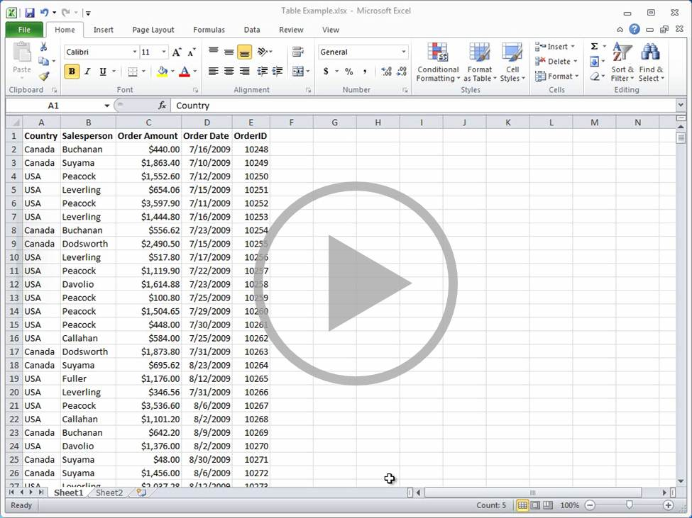
Introduction to tables
Point to the bottom of the video to see the video controls. Drag or point along the progress bar to move forward or go back.
Notes:
[Note to trainer: If you have trouble playing this video, for instance if a Codec Unavailable message appears in the video playback window, the presentation might have opened in Protected View. To enable video playback, in the yellow security bar at the top of the PowerPoint window, click Enable Editing. Note that even with Protected View turned on, video should play correctly in Slide Show view.]

Slide 7
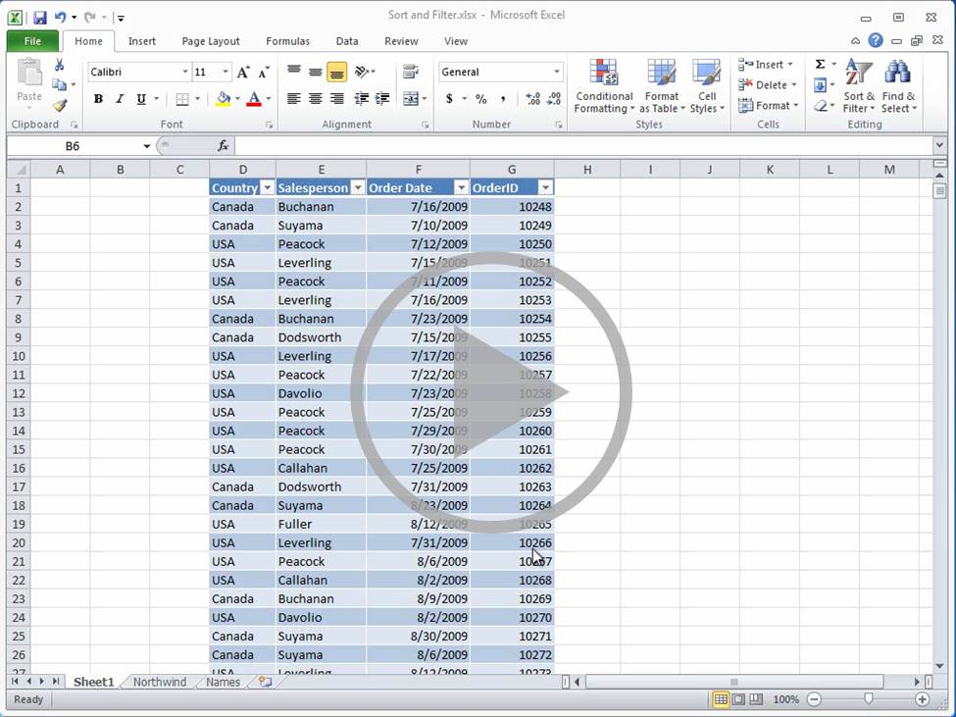
Sort, filter, and remove duplicates
Point to the bottom of the video to see the video controls. Drag or point along the progress bar to move forward or go back.
Notes:
[Note to trainer: If you have trouble playing this video, for instance if a Codec Unavailable message appears in the video playback window, the presentation might have opened in Protected View. To enable video playback, in the yellow security bar at the top of the PowerPoint window, click Enable Editing. Note that even with Protected View turned on, video should play correctly in Slide Show view.]

Slide 8
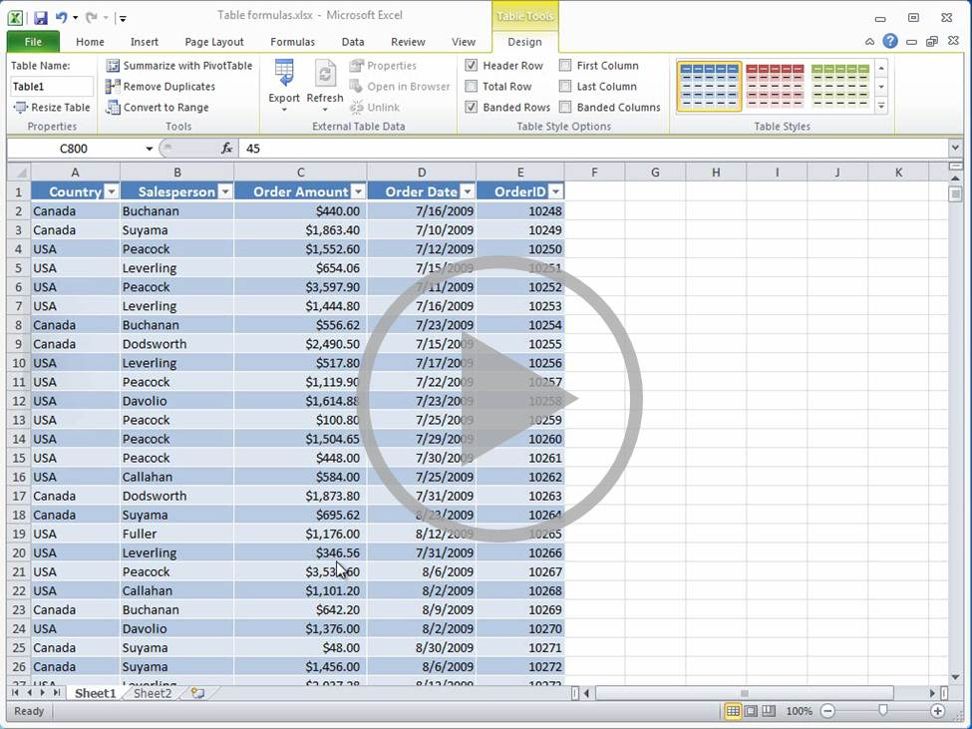
Using formulas in tables
Point to the bottom of the video to see the video controls. Drag or point along the progress bar to move forward or go back.
Notes:
[Note to trainer: If you have trouble playing this video, for instance if a Codec Unavailable message appears in the video playback window, the presentation might have opened in Protected View. To enable video playback, in the yellow security bar at the top of the PowerPoint window, click Enable Editing. Note that even with Protected View turned on, video should play correctly in Slide Show view.]

Slide 9
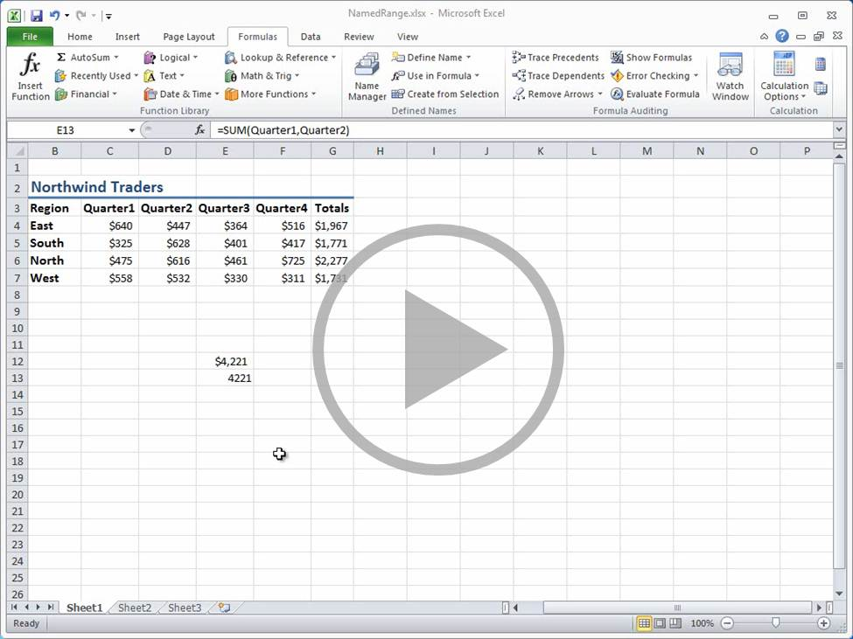
More about formulas
Point to the bottom of the video to see the video controls. Drag or point along the progress bar to move forward or go back.
Notes:
[Note to trainer: If you have trouble playing this video, for instance if a Codec Unavailable message appears in the video playback window, the presentation might have opened in Protected View. To enable video playback, in the yellow security bar at the top of the PowerPoint window, click Enable Editing. Note that even with Protected View turned on, video should play correctly in Slide Show view.]

Slide 10
Suggestions for practice
Create a table.
Change the table formatting.
Add and delete rows and columns.
Sort a table; filter a table.
Create an auto fill formula.
Add a total row.
Add the order amount and the commissions.
Online practice (requires Excel 2010)
Notes:
[Note to trainer: With Excel 2010 installed on your computer, you can click the link in the slide to go to an online practice. In the practice, you can work through each of these tasks in Excel 2010, with instructions to guide you. Important: If you don’t have Excel 2010, you won’t be able to access the practice instructions.]

Slide 11
Test question 1
You can sort more than one column at a time. (Pick one answer.)
True.
False.

Slide 12
Test question 1
You can sort more than one column at a time.
Answer:
False.
You can only sort on one column at a time.

Slide 13
Test question 2
You can filter more than one column at a time. (Pick one answer.)
True.
False.

Slide 14
Test question 2
You can filter more than one column at a time.
Answer:
True.
You can filter as many columns as you want to.

Slide 15
Test question 3
To fill a formula down a column, you copy and paste it from the first cell into the other cells in the column. (Pick one answer.)
True.
False.

Slide 16
Test question 3
To fill a formula down a column, you copy and paste it from the first cell into the other cells in the column.
Answer:
False.
Excel will automatically fill the rest of the column with the formula.

Slide 17
Test question 4
As you type a formula in a table, to see a list of the column names to enter into the formula, type a parenthesis (. (Pick one answer.)
True.
False.

Slide 18
Test question 4
As you type a formula in a table, to see a list of the column names to enter into the formula, type a parenthesis (.
Answer:
False.
Type a square bracket ([) to see a list of the column names to include in the formula.

Slide 19
Test question 5
What does it mean when you see a small upward pointing arrow on the drop-down button at the top of a column? (Pick one answer.)
The column is filtered.
The column is sorted.

Slide 20
Test question 5
What does it mean when you see a small upward pointing arrow on the drop-down button at the top of a column?
Answer:
The column is sorted.

Slide 21
Quick Reference Card
For a summary of the tasks covered in this course, view the Quick Reference Card.

Slide 22
Using this template
See the notes pane or view the full notes page (View tab, Notes Page) for detailed help on this template.
Notes:
Using This Template
This Microsoft PowerPoint® template has training content about working with tables in Microsoft Excel® 2010. Its content is adapted from the Office.com Training course called “Use Excel tables to manage information.”
PowerPoint version: The template must be viewed in PowerPoint 2010. If you don’t have PowerPoint 2010, the videos included in the presentation will not play. If you don’t have PowerPoint 2010, download the PowerPoint Viewer to view these files (http://www.microsoft.com/downloads/details.aspx?displaylang=en&FamilyID=cb9bf144%2D1076%2D4615%2D9951%2D294eeb832823). Video playback: If the yellow security bar appears at the top of the screen in PowerPoint, or if a Codec Unavailable message appears in the video playback window, the presentation might have opened in Protected View. To enable video playback, in the yellow security bar at the top of the PowerPoint window, click Enable Editing.
Slide layouts: Each slide has a custom layout. To apply the custom layout to a new slide, right-click the slide thumbnail, point to Layout, and click the layout from the Layout gallery. To alter the layouts, open master view and alter the specific master layout in that view. You can find the layout’s title by pointing to its thumbnail.
Animations: Custom animation effects are applied throughout the presentation. These include Float In (Up or Down option), Fade, and Zoom. To alter animation effects, click the Animations tab, and use the Add Animation gallery and Timing options. Effect Options gives you choices about the effect; click Animation Pane on the Animations tab to work with multiple animations.
Transitions: One transition, Doors, is used to emphasize sections of the slide show. It’s applied on the Course Contents slide, Lesson slide, and the first test slide.
Hyperlinks to online course: The template contains links to the online version of this training course that take you to the hands-on practice session for the lesson and to the Quick Reference Card that is published for the course. Please take note: You must have Excel 2010 installed to view the hands-on practice session. If you don’t have Excel 2010, you won’t be able to access the practice instructions.
Headers and footers: The template contains a footer that has the course title. To add footers such as the date or slide numbers, click the Insert tab, and click Header & Footer.

